Slide 1
Lists
Implementing a general list structure

Slide 2
Out own List
We have been using the python List for the underlying implementation for a lot of our linear structures
It's a powerful yet simple collection mechanism that has a wide variety of operations
Lets look at List as a linear structure and examine how we would make our own

Slide 3
List General
A unordered (unsorted) list is a
collection of items
each item hold a relative position relative to the other items
the list has a first item, a second item, etc.
we can refer to both the first and the last item of a list

Slide 4
potential List operations:
List() new list
add(item) add to front
remove(item) find and remove item
search(item) return true if found
isEmpty() return true if so
length() return # of items
append(item) add to end
index(item) return position 0 to n-1
pop() remove and return last item
pop(pos) remove and add pos item 0 to n-1
set(pos, item) replace item at pos
get(pos) return item at pos

Slide 5
variable relation to memory
Mem Addr/data
00100
00104
00108
00112
00116
00120
00124
00128
00132
00136
00140
00144

Slide 6
variable relation to memory
count = 203
Mem Addr/data
00100
00104
00108
00112
00116
00120
00124
00128
00132
00136
00140
00144

Slide 7
variable relation to memory
count = 203
Mem Addr/data
00100
00104
00108
00112
00116
00120
00124 | 203
00128
00132
00136
00140
00144
a empty memory location is picked, say
location 00124 and and assigned to count
then 203 is copied to the memory location
assigned to count
count(address 00124)

Slide 8
variable relation to memory
count = 203
Mem Addr/data
00100
00104
00108
00112
00116
00120
 | 203
00128
00132
00136
00140
00144
From an abstract point of view, we just
need to think of count referring to the new
data in memory: count points to the data
count

Slide 9
variable relation to memory
count = 203
Mem Addr/data
00100
00104
00108
00112
00116
00120
 | 203
00128
00132
00136
00140
00144
From an abstract point of view, we just
need to think of count referring to the new
data in memory: count points to the data
count

Slide 10
variable relation to memory
When we have more complex data it can be a object with several fields
class Point:
def __init__(self,x,y):
self.x = x
self.y = y
p1 = Point(10,20)
p2 = Point(15, 5)
10
20
p1
p2
15
5

Slide 11
What does it look like in memory?
consider
a = [ 'a', ['b', ['c', None]]]
Draw as pointers, what doe it look like?
look at with python visualizer

Slide 12
What does it look like in memory?
consider
a = [ 'a', ['b', ['c', None]]]
a
'a'
'b'
'c' | None

Slide 13
Node Class Simple Form
class Node:
def __init__(self, data):
self.data = data
self.next = None
first = Node('a')
first.next = Node('b')
first.next.next = Node('c')
look at with python visualizer

Slide 14
# full node class
class Node: def __init__(self,initdata): self.data = initdata self.next = None def getData(self):
return self.data def getNext(self):
return self.next def setData(self,newdata):
self.data = newdata def setNext(self,newnext):
self.next = newnext

Slide 15
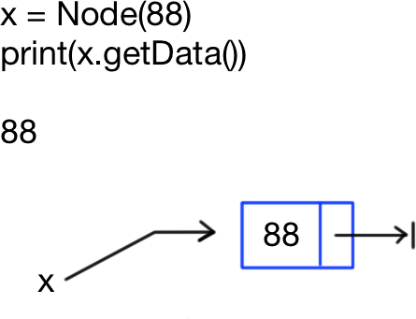
Create Node with data

Slide 16
class UnorderedList
class UnorderedList:
def __init__(self):
self.head = None
def isEmpty(self):
return self.head == None
def add(self,item):
temp = Node(item)
temp.setNext(self.head)
self.head = temp

Slide 17

def add(self,item):
a: temp = Node(item)
b: temp.setNext(self.head)
c: self.head = temp
1: t = UnorderedList()
2: t.add(54)
after 1:

Slide 18
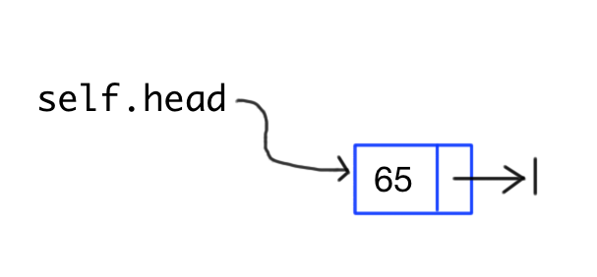
def add(self,item):
a: temp = Node(item)
b: temp.setNext(self.head)
c: self.head = temp
1: t = UnorderedList()
2: t.add(54)
after t.add(54):

Slide 19
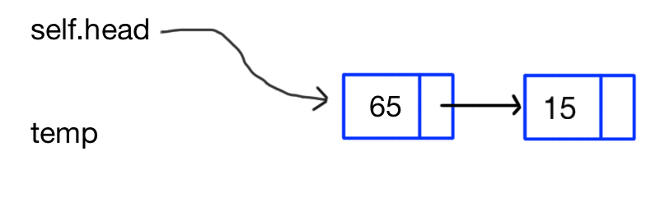
add node steps
a: temp = Node(33)
b: temp.setNext(self.head)
c: self.head = temp

Slide 20
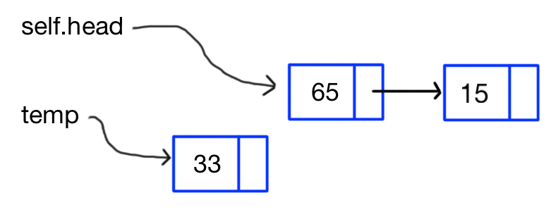
add node steps
a: temp = Node(33)
b: temp.setNext(self.head)
c: self.head = temp

Slide 21
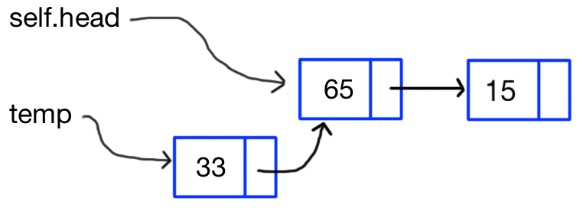
add node steps
a: temp = Node(33)
b: temp.setNext(self.head)
c: self.head = temp

Slide 22
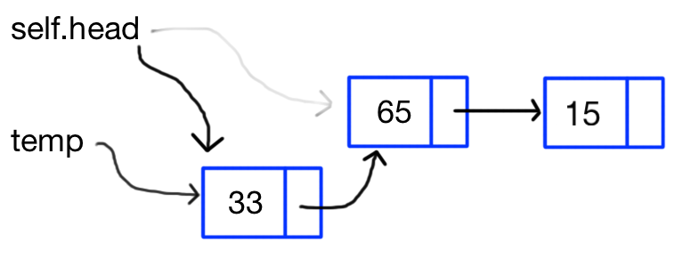
add node steps
a: temp = Node(33)
b: temp.setNext(self.head)
c: self.head = temp

Slide 23
add node steps
a: temp = Node(33)
b: temp.setNext(self.head)
c: self.head = temp

Slide 24
Traversing a list
Unlike a python list or an array in other languages, we can't just access the middle by some index number such as alist[2]
So to get to the 3rd element of a list or search for an element we must do what is called:
traverse the list

Slide 25
traverse a list
we traverse a list by starting at head and following the next links to each node on list
current = self.head
while current != None:
# place to put code for current
current = current.getNext()

Slide 26
self.head
11
11
11
11
11
33
12
6
95
4

Slide 27
self.head
11
11
11
11
11
33
12
6
95
4
current

Slide 28
self.head
11
11
11
11
11
33
12
6
95
4
current

Slide 29
self.head
11
11
11
11
11
33
12
6
95
4
current

Slide 30
self.head
11
11
11
11
11
33
12
6
95
4
current

Slide 31
self.head
11
11
11
11
11
33
12
6
95
4
current

Slide 32
self.head
11
11
11
11
11
33
12
6
95
4
current
When current is set to None, loop ends

Slide 33
traverse to get length
current = self.head
count = 0
while current != None:
count += 1
current = current.getNext()
# count is now the length

Slide 34
traverse to get i^{th} element
current = self.head
count = 0
while current != None:
if count == i:
return current.getData()
count += 1
current = current.getNext()

Slide 35
traverse to search for match to item
def search(self,item):
current = self.head
while current != None:
if current.getData() == item:
return True
current = current.getNext()
return False

Slide 36

Consider removing third item
Before remove
self.head
11
11
11
11
11
33
12
6
95
4
After remove
self.head
11
11
11
11
11
33
12
6
95
4

Slide 37
Consider removing third item
current
self.head
11
11
11
11
11
33
12
6
95
4
current
self.head
11
11
11
11
11
33
12
6
95
4

Slide 38
Consider removing third item
current
self.head
11
11
11
11
11
33
12
6
95
4
current
self.head
11
11
11
11
11
33
12
6
95
4

Slide 39
Consider removing third item
current
self.head
11
11
11
11
11
33
12
6
95
4
Opps, we have advanced past the node we need to change
current
self.head
11
11
11
11
11
33
12
6
95
4

Slide 40
Consider removing third item
previous
current
self.head
11
11
11
11
11
33
12
6
95
4
previous
current
self.head
11
11
11
11
11
33
12
6
95
4

Slide 41
There is a problem
def remove(self,item):
current = self.head
previous = None
while current != None:
if current.getData() == item:
previous.
setNext(current.getNext())
return
previous = current # remember
current = current.getNext()
return current.getData()

Slide 42
There is a problem
def remove(self,item):
current = self.head
previous = None
while current != None:
if current.getData() == item
previous.next = current
return
previous = current # remember
current = current.getNext()
return current.getData()
What if the first item in list is a match?

Slide 43
There is a problem
def remove(self,item):
current = self.head
previous = None
while current != None:
if current.getData() == item:
previous.setNext(current)
return
previous = current # remember
current = current.getNext()
return current.getData()
What if the first item in list is a match? … then previous does not point to anything!
In this case we need to change self.head
to point to the next node.

Slide 44
Special Case for remove first
def remove(self,item):
current = self.head
previous = None
while current != None:
if current.getData() == item
if previous == None:
self.head = current
else:
previous.next current
return
previous = current # remember
current = current.getNext()
return current.getData()

Slide 45
Special Cases
Special Case often arise in algorithms when the are at the beginning, end of sequence and when the list is empty
Always consider and TEST if your code works when applied to the first and last member of a sequence, and when the list is empty before or after your operation.
This will be important to consider when you do the double linked list homework!

Slide 46
The Ordered List (sorted)
an ordered list is just a list that the sequence of items is maintained in a specific order, usually sorted either numerically or alphabetically.
You can use most of what we already know of unordered lists and the only operation we really need to change is how to insert a new item so the list is in order after we do the insert.

Slide 47
Here is an ordered list
self.head
11
11
11
11
11
5
7
15
34
85
Note that all the existing nodes are in increasing order

Slide 48
insert(11)
1. find first note that is bigger than 11
previous
current
self.head
11
11
11
11
11
5
7
15
34
85

Slide 49
insert(11)
previous
current
self.head
11
11
11
11
11
5
7
15
34
85
11
11
the new node goes between previous and next
2. adjust next links of new node and previous

Slide 50
insert with special case
def add_order(self,item): current = self.head previous = None n = Node(item) stop = False while current != None and not stop: if current.getData() > item: stop = True else: previous = current # remember current = current.getNext() if previous == None: n.setNext(self.head) self.head = n else: n.setNext(current) previous.setNext(n) return

Slide 51
Big O of lists
Every method on a list that does traversal must have from 0 to n steps.
So these methods O(n) for
length, remove(item), append, pop(i), search(item), index(item), insert(pos,item), pop(), and pop(i)

Slide 52
double linked list diagram
Nodes in a double link list have a link to both next and previous
self.front
self.rear
14
next
prev
5
next
prev
45
next
prev
3
next
prev
25
next
prev
11
11
11
11
11
class node:
def __init__(self,data):
self.data = data
self.next = None
self.prev = None

Slide 53
End of Chapter 3 on Basic Data Structures (linear)

